Slide 1
Chapter 8: Deadlocks
System Model
Deadlock Characterization
Methods for Handling Deadlocks
Deadlock Prevention
Deadlock Avoidance
Deadlock Detection
Recovery from Deadlock
Operating System Concepts

Slide 2
Bridge Crossing Example
Traffic only in one direction.
Each section of a bridge can be viewed as a resource.
If a deadlock occurs, it can be resolved if one car backs up (preempt resources and rollback).
Several cars may have to be backed up if a deadlock occurs.
Starvation is possible.
Operating System Concepts

Slide 3
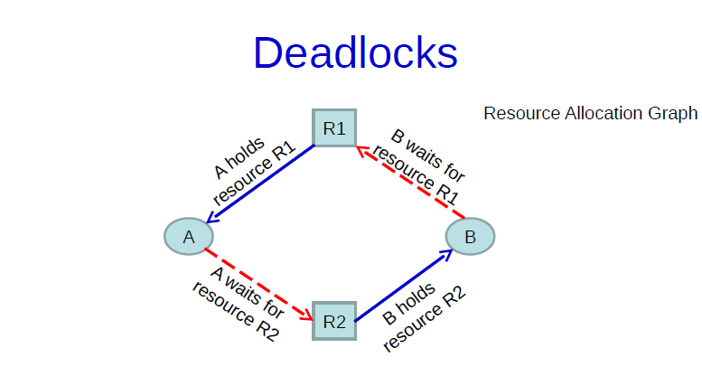
Deadlock is a situation where a set of processes are blocked because each process is holding a resource and waiting for another resource acquired by some other process.

Slide 4
The Deadlock Problem
A set of blocked processes each holding a resource and waiting to acquire a resource held by another process in the set.
Example
  System has one file and one printer.
  P₁ holds the file (R1) and request the printer (R2) and P₂ hold the printer (R2) and request the access to the file (R1).
Deadlock is a very critical situation that would occur in systems.
It could lead to process A and B in this case waiting for an infinite time continuously waiting without doing any useful work

Slide 5
System Model
A set of blocked processes each holding a resource and waiting to acquire a resource held by another process in the set.
Example of a deadlock problem:
  System has 2 tape drives.
  Process P₁ and process P₂ each hold one tape drive and each needs another one.
A system consists of a finite number of resources to be distributed among a number of competing processes.
Resource types R₁, R₂, . . ., R_{m}
    CPU cycles, memory space, I/O devices
The resources may be either physical (printers, tape drives, memory space, and CPU cycles) or logical (files and semaphores).
A process must request a resource before using it, and must release the resource after using it.
Operating System Concepts

Slide 6
System Model
A process may utilize a resource in only the following sequence:
  Request: If the request cannot be granted immediately, then the requesting process must wait until it can acquire the resource.
  Use: The process can operate on the resource (ex., print on printer).
  Release: The process releases the resource.
The request and release of resources are system calls (examples: request and release device, open and close file, and allocate and free memory system calls).
Request and release of other resources can be accomplished through the wait and signal operations on semaphores.
Operating System Concepts

Slide 7
Deadlock Characterization
Deadlock can arise if four conditions hold simultaneously.
Mutual exclusion: only one process at a time can use a resource. If another process requests that resource, the requesting process must be delayed until the resource has been released.
Hold and wait: a process is holding at least one resource and is waiting to acquire additional resources held by other processes (i.e., you hold a resource and wait for another one).
No preemption: a resource can be released only voluntarily by the process holding it, after that process has completed its task (ex., in FCFS a process use the CPU until it terminates).
Circular wait: there exists a set {P₀, P₁, …, P₀} of waiting processes such that P₀ is waiting for a resource that is held by
P₁, P₁ is waiting for a resource that is held by P₂, …, P_{n–1} is waiting for a resource that is held by P_{n}, and P₀ is waiting for a resource that is held by P₀.
Operating System Concepts

Slide 8
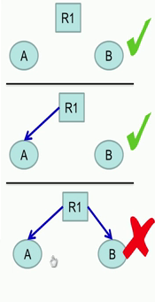
Mutual Exclusion
  Each resource in the system is either available or currently assigned to exactly one process
R 1 which is free (1st figure). So, it is not assigned to any particular process, so this is fine.
It is also fine (2nd figure) where the resource is allocated to exactly one process,
In order that deadlocks happen this kind of scenario (3rd figure) should not be present that is the resource cannot be shared between two processes A and B.

Slide 9
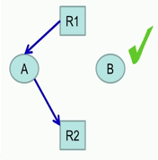
Hold and Wait
process holding a resource can request another resource
the resource R1 is held by process A. and while having R1, A is also requesting for another resource R 2, so it essentially holding R 1 and waiting for R 2.

Slide 10

No preemption
Resources previously granted can’t be forcibly taken away from a process
Resources must be explicitly released by the process holding it

Slide 11
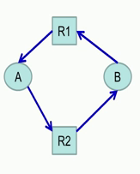
Circular wait
There is a circular chain of 2 or more processes, each of which is waiting for a resource held by the next member of the chain

Slide 12
Resource-Allocation Graph
A deadlock can be described in terms of a directed graph called system resource-allocation graph.
A set of vertices V and a set of edges E.
  V is partitioned into two types:
    P = {P₁, P₂, …, P_{n}}, the set consisting of all the processes in the system.
    R = {R₁, R₂, …, R_{m}}, the set consisting of all resource types in the system.
  request edge – directed edge P_{i} → R_{j}
  assignment edge – directed edge R_{j} → P_{i}
Operating System Concepts

Slide 13
Resource-Allocation Graph (Cont.)
Process:
Resource type with 4 instances of same type:
For example four printers
P_{i} requests instance of R_{j}
P_{i} is holding an instance of R_{j}
P_{i}
R_{j}
P_{i}
R_{j}
Operating System Concepts

Slide 14
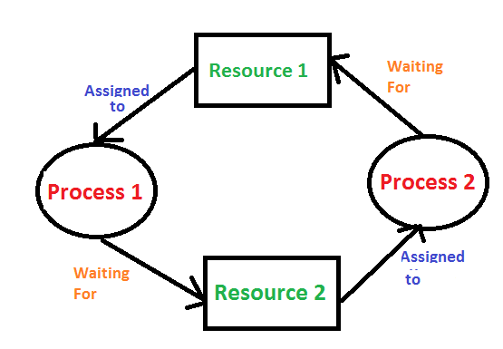
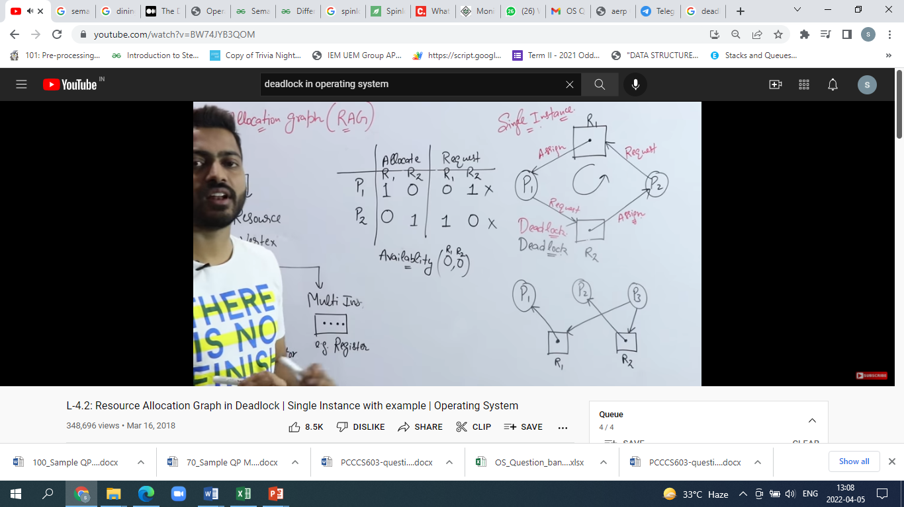
Deadlocked?
There is a circular chain of 2 or more processes, each of which is waiting for a resource held by the next member of the chain

Slide 15

Example of a Resource Allocation Graph
Process State:
  P1 is holding an instance of R2 and waiting for an instance of R1.
  P2 is holding an instance of R1 and R2, and is waiting for an instance of R3.
  P3 is holding an instance of R3.
The graph does not contain any cycles. What does that mean?
Operating System Concepts

Slide 16

Resource Allocation Graph With A Deadlock
Two minimal cycles exist in the
system:
P1 R1 P2 R3 P3 R2 P1
P2 R3 P3 R2 P2
Processes P1, P2, P3 are
deadlocked.
P2 is waiting for R3, which is held
by P3.
P3 is waiting for P1 or P2 to
release R2.
P1 is waiting for P2 to release R1.
Operating System Concepts

Slide 17

Resource Allocation Graph With A Cycle But No Deadlock
We have a cycle:
P1 R1 P3 R2 P1
There is no deadlock.
P4 may release its instance of
R2 and that resource can then
be allocated to P3 breaking the
cycle.
If graph contains no cycles ⇒ no deadlock.
If graph contains a cycle ⇒
  if only one instance per resource type, then deadlock.
  if several instances per resource type, possibility of deadlock.
Operating System Concepts

Slide 18
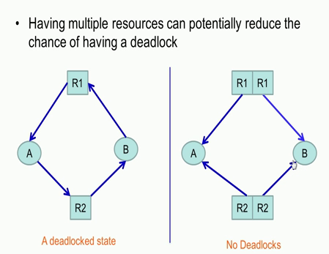
Multiple Resources

Slide 19
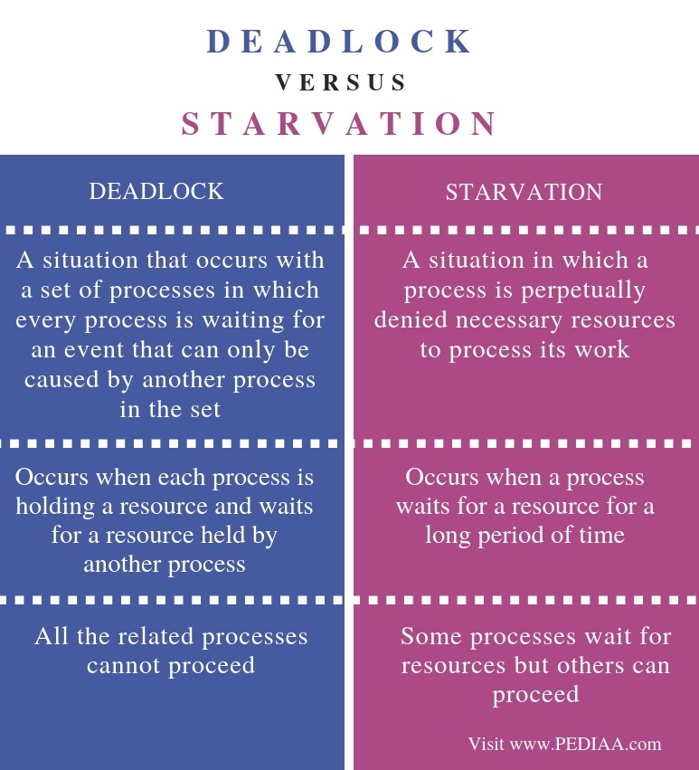
Deadlock vs Starvation
Operating System Concepts

Slide 20
Methods for Handling Deadlocks
Ensure that the system will never enter a deadlock state.
  The system can use either a deadlock prevention or avoidance.
Allow the system to enter a deadlock state and then recover.
Ignore the problem and pretend that deadlocks never occur in the system; used by most operating systems, including UNIX (need to restart your computer if a deadlock occur).
Operating System Concepts

Slide 21
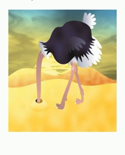
Ignoring Deadlock (Ostrich method)
Stick your head in the sand and pretend there is no problem at all, this method of solving any problem is called Ostrich Algorithm. The method of solving any problem varies according to the people.

Slide 22
Deadlock Prevention
For a deadlock to occur, each of the four necessary conditions must hold.
By ensuring that at least one of these conditions cannot hold, we can prevent the occurrence of a deadlock.
Mutual Exclusion – not required for sharable resources; must hold for non-sharable resources.
  For example, a printer cannot be simultaneously shared by several processes.
  A process never needs to wait for a sharable resource.
Hold and Wait – must guarantee that whenever a process requests a resource, it does not hold any other resources.
  One protocol requires each process to request and be allocated all its resources before it begins execution,
  Or another protocol allows a process to request resources only when the process has none. So, before it can request any additional resources, it must release all the resources that it is currently allocated.
Operating System Concepts

Slide 23
Deadlock Prevention (Cont.)
  Example to illustrate the difference between the two protocols: A process copies data from a tape drive to a disk file, sorts the disk file, and then prints the results to a printer.
  Protocol 1: request all tape, disk, printer and hold for entire execution; note printer will be idle for a long time.
  Protocol 2: request tape and disk only after copying release both then request disk and printer after printing release both.
Tape
Disk
Printer
Operating System Concepts

Slide 24
Deadlock Prevention (Cont.)
  Two main disadvantages to these protocols:
  Low resource utilization: since many of the resources may be allocated but unused for a long time.
  starvation possible: A process that needs several popular resources may have to wait indefinitely, because at least one of the resources that it needs is always allocated to some other process.
Operating System Concepts

Slide 25
Deadlock Prevention (Cont.)
No Preemption – To ensure that this condition does not hold, we can use the following protocol:
  If a process that is holding some resources requests another resource that cannot be immediately allocated to it, then all resources currently being held are released.
  Preempted resources are added to the list of resources for which the process is waiting.
  Process will be restarted only when it can regain its old resources, as well as the new ones that it is requesting.
Operating System Concepts

Slide 26
Deadlock Prevention (Cont.)
Circular Wait – To ensure that the circular-wait condition never holds is to determine a total ordering of all resource types, and to require that each process requests resources in an increasing order of enumeration.
  Example: Let R={R1, R2, …, Rm} be the set of resource types.
  Assign to each resource type a unique integer number to compare two resources and to determine whether one proceeds another in ordering.
  For example: If the set of resource types R includes tape drives, disk drives, and printers, then a function F might be defined as follows:
  F(tape drive)= 1; F(disk drive)= 5; F(Printer)= 12.
Operating System Concepts

Slide 27
Deadlock Prevention (Cont.)
A protocol to prevent deadlocks: Each process can request resources only in an increasing order of enumeration.
  A process can initially request any number of instances of a resource type Ri.
  That process can request instances of resource type Rj if and only if F(Rj)>F(Ri).
  From the previous example; a process wants to use the tape drive and printer at the same time, must first request the tape drive and then the printer.
  When a process requests an instance of resource type Rj, it has released any resources Ri such that F(Ri)>=F(Rj).
  By applying 1 and 2 then the circular-wait condition cannot hold.
Operating System Concepts

Slide 28
Deadlock Avoidance
Requires that the system has some additional a priori information about how resources are to be requested.
Simplest and most useful model requires that each process declare the maximum number of resources of each type that it may need.
The deadlock-avoidance algorithm dynamically examines the resource-allocation state to ensure that there can never be a circular-wait condition.
Resource-allocation state is defined by the number of available and allocated resources, and the maximum demands of the processes.
Operating System Concepts

Slide 29
Safe State
A state is safe if the system can allocate resources to each process (up to its maximum) in some order and still avoid a deadlock.
System is in safe state if there exists a safe sequence of all processes.
Sequence <P₁, P₂, …, P_{n}> is safe if for each P_{i}, the resources that Pi can still request can be satisfied by currently available resources + resources held by all the P_{j}, with j<i.
  If P_{i} resource needs are not immediately available, then P_{i} can wait until all P_{j} have finished.
  When P_{j} is finished, P_{i} can obtain needed resources, execute, return allocated resources, and terminate.
  When P_{i} terminates, P_{i+1} can obtain its needed resources, and so on.
Operating System Concepts

Slide 30
Safe State Example
A system with 12 tape drives and 3 processes; P0, P1, P2.
The following Table at state t0.
At t0 the system is in a safe state, because the sequence <P1, P0, P2> satisfies the safety condition.
9 tape drives total at t0 been held, so a total of 3 tape drives are free available.
Process | Max Need | Current hold
P0 | 10 | 5
P1 | 4 | 2
P2 | 9 | 2
Release 4
Release 10
Release 9
P1
P0
P2
Hold 2 Request 2
Hold 5 Request 5
Hold 2 Request 7
Operating System Concepts

Slide 31
Safe State Example (Cont.)
For unsafe state suppose at t1, P2 requests and is holding one more tape drive as shown below:
This sequence <P1, P0, P2> is unsafe; only P1 can be satisfied. P0 and P2 must waits yielding to a deadlock.
10 tape drives total at t1 been held, so a total of 2 tape drives are free available.
Process | Max Need | Current hold
P0 | 10 | 5
P1 | 4 | 2
P2 | 9 | 3
Operating System Concepts

Slide 32

Basic Facts
If a system is in safe state ⇒ no deadlocks.
If a system is in unsafe state ⇒ possibility of deadlock.
Avoidance ⇒ ensure that a system will never enter an unsafe state.
Safe, unsafe , deadlock state spaces.
Operating System Concepts

Slide 33
Resource-Allocation Graph Algorithm
Claim edge P_{i} R_{j} indicated that process P_{i} may request resource R_{j}; represented by a dashed line.
Claim edge converts to request edge when a process requests a resource.
When a resource is released by a process, assignment edge reconverts to a claim edge.
Resources must be claimed a priori in the system.
If a cycle is found in a graph, then the allocation will put the system in an unsafe state.
If no cycle exists, then the allocation of the resource will leave the system in a safe state.
Operating System Concepts

Slide 34


Resource-Allocation Graph For Deadlock Avoidance
Figure 1:
Figure 2:
Figure 2 shows an unsafe state in a resource-allocation graph, because there is a cycle in the graph.
The resource-allocation graph algorithm is not applicable to a resource-allocation system with multiple instances of each resource type.
Operating System Concepts

Slide 35
Banker’s Algorithm
Banker’s algorithm is applicable to a resource-allocation system with multiple instances of each type.
From it’s name, it could be used in a banking system to ensure that the bank never allocates its available cash such that it can no longer satisfy the needs of all customers.
Each process must a priori claim maximum use.
When a process requests a resource it may have to wait.
When a process gets all its resources it must return them in a finite amount of time.
Operating System Concepts

Slide 36
Data Structures for the Banker’s Algorithm
Let n = number of processes, and m = number of resource types.
  Available: Vector of length m indicates the number of available resources of each type. If available [j] = k, there are k instances of resource type R_{j} available.
  Max: n x m matrix defines the maximum demand of each process. If Max [i,j] = k, then process P_{i} may request at most k instances of resource type R_{j}.
  Allocation: n x m matrix defines the number of resources of each type currently allocated to each process. If Allocation[i,j] = k then P_{i} is currently allocated k instances of of resource type R_{j.}
  Need: n x m matrix indicates the remaining resource need of each process. If Need[i,j] = k, then P_{i} may need k more instances of R_{j} to complete its task.
    Need [i,j] = Max[i,j] – Allocation [i,j].
Operating System Concepts

Slide 37
Safety Algorithm (Banker’s Algorithm)
1. Let Work and Finish be vectors of length m and n, respectively.
Initialize:
      Work := Available
      Finish [i] = false for i - 1,3, …, n.
2. Find an i such that both:
  (a) Finish [i] = false
  (b) Need_{i} ≤ Work
  If no such i (no process) exists, go to step 4.
3. Work := Work + Allocation_{i}
Finish[i] := true
go to step 2.
4. If Finish [i] = true for all i, then the system is in a safe state.
Operating System Concepts

Slide 38
Resource-Request Algorithm for Process P_{i}
Request_{i} = request vector for process P_{i}. If Request_{i} [j] = k then process P_{i} wants k instances of resource type R_{j.}
When a request for resources is made by process P_{i}, the following actions are taken:
  1. If Request_{i} ≤ Need_{i} go to step 2. Otherwise, raise error condition, since process has exceeded its maximum claim.
  2. If Request_{i} ≤ Available, go to step 3. Otherwise P_{i} must wait, since resources are not available.
  3. Pretend to allocate requested resources to P_{i} by modifying the state as follows:
      Available := Available - Request_{i};
      Allocation_{i} := Allocation_{i} + Request_{i};
      Need_{i} := Need_{i} – Request_{i;;}
    If safe ⇒ the resources are allocated to P_{i}.
    If unsafe ⇒ P_{i} must wait, and the old resource-allocation state is restored
Operating System Concepts

Slide 39
Example of Banker’s Algorithm
5 processes P₀ through P₄; 3 resource types A (10 instances),
B (5 instances, and C (7 instances).
Snapshot at time T₀: (Need= Max - Allocation)
The system is in a safe state since the sequence
< P₁, P₃, P₄, P₀, P₂> satisfies safety criteria.
Process | Allocation | Max | Available | Need | Available after Release
 | A B C | A B C | A B C | A B C | A B C
P0 | 0 1 0 | 7 5 3 | 3 3 2 | 7 4 3 | 7 5 5
P1 | 2 0 0 | 3 2 2 |  | 1 2 2 | 5 3 2
P2 | 3 0 2 | 9 0 2 |  | 6 0 0 | 10 5 7
P3 | 2 1 1 | 2 2 2 |  | 0 1 1 | 7 4 3
P4 | 0 0 2 | 4 3 3 |  | 4 3 1 | 7 4 5
Operating System Concepts

Slide 40
Example (Cont.): P₁ request (1,0,2)
Check that Request ≤ Need (that is, (1,0,2) ≤ (1,2,2) is true).
Check that Request ≤ Available (that is, (1,0,2) ≤ (3,3,2) is true).
Allocation Need Available Available After Release
A B C A B C A B C A B C
P₀ 0 1 0 7 4 3 2 3 0 7 5 5
P₁ 3 0 2 0 2 0 5 3 2
P₂ 3 0 2 6 0 0 10 5 7 (finish)
P₃ 2 1 1 0 1 1 7 4 3
P₄ 0 0 2 4 3 1 7 4 5
Executing safety algorithm shows that sequence <P₁, P₃, P₄, P₀, P₂> satisfies safety requirement.
Operating System Concepts

Slide 41
Example (Cont.)
Can request for (3,3,0) by P₄ be granted?
  Check Request ≤ Need (that is, (3,3,0) ≤ (4,3,1)) is true).
  Check Request ≤ Available (that is, (3,3,0) ≤ (2,3,0) is not true).
  So, the request for (3,3,0) by P₄ can not be granted.
Can request for (0,2,0) by P₀ be granted?
  Check Request ≤ Need (that is, (0,2,0) ≤ (7,4,3) is true).
  Check Request ≤ Available (that is, (0,2,0) ≤ (2,3,0) is true).
  However, since Available becomes 2 for A, 1 for B, and 0 for C, we can not find a sequence to satisfy the safety requirements. Therefore, the resulting state is unsafe and the request for (0,2,0) by P₀ can not be granted.
Operating System Concepts

Slide 42
Deadlock Detection
If a system does not employ a deadlock prevention algorithm or a deadlock avoidance algorithm, then a deadlock situation may occur.
Therefore, the system must provide:
  Detection: an algorithm that examines the state of the system to determine whether a deadlock has occurred.
  Recovery: an algorithm to recover from the deadlock.
A detection and recovery scheme requires overhead that includes:
  Run-time costs of maintaining the necessary information.
  Executing the detection algorithm.
  The potential losses inherent in recovering from a deadlock.
Operating System Concepts

Slide 43
Single Instance of Each Resource Type
A deadlock detection algorithm uses a variant of the resource-allocation graph called wait-for graph.
An edge from Pi to Pj in a wait-for graph implies that process Pi is waiting for process Pj to release a resource that Pi needs.
An edge Pi Pj exists in a wait-for graph if and only if the corresponding resource-allocation graph contains two edges
Pi Rq and Rq Pj for some resource Rq.
A deadlock exists in the system if and only if the wait-for graph contains a cycle.
To detect deadlocks, the system needs to:
  Maintain the wait-for graph.
  Periodically invoke an algorithm that searches for a cycle in the graph.
An algorithm to detect a cycle in a graph requires an order of n² operations, where n is the number of vertices in the graph.
Operating System Concepts

Slide 44

Resource-Allocation Graph And Wait-for Graph
Resource-Allocation Graph
Corresponding wait-for graph
The wait-for graph scheme is not applicable to a resource-allocation system with multiple instances of each resource type.
Operating System Concepts

Slide 45
Several Instances of a Resource Type
The algorithm employs several time-varying data structures that are similar to those used in the banker’s algorithm:
  Note: n is number of processes in the system and m is the number of resource types.
  Available: A vector of length m indicates the number of available resources of each type.
  Allocation: An n x m matrix defines the number of resources of each type currently allocated to each process.
  Request: An n x m matrix indicates the current request of each process. If Request [i,j] = k, then process P_{i} is requesting k more instances of resource type. R_{j}.
Operating System Concepts

Slide 46
Detection Algorithm
1. Let Work and Finish be vectors of length m and n, respectively.
Initialize:
  (a) Work := Available
  (b) For i = 1,2, …, n, if Allocation_{i} ≠ 0, then
  Finish[i] := false; otherwise, Finish[i] := true.
2. Find an index i such that both:
  (a) Finish[i] = false
  (b) Request_{i} ≤ Work (Pi not involved in deadlock)
  If no such i exists, go to step 4.
Operating System Concepts

Slide 47
Detection Algorithm (Cont.)
3. Work := Work + Allocation_{i}
Finish[i] := true (Assume Pi will require no more resources to complete).
go to step 2.
4. If Finish[i] = false, for some i, 1 ≤ i ≤ n, then the system is in deadlock state. Moreover, if Finish[i] = false, then P_{i} is deadlocked.
Algorithm requires an order of m x n² operations to detect whether the system is in deadlocked state.
Operating System Concepts

Slide 48
Example of Detection Algorithm
Five processes P₀ through P₄; three resource types
A (7 instances), B (2 instances), and C (6 instances).
Snapshot at time T₀:
Ava-New Allocation Request Available Request (New)
A B C A B C A B C A B C
0 1 0 P₀ 0 1 0 0 0 0 0 0 0 0 0 0
7 2 4 P₁ 2 0 0 2 0 2 2 0 2
3 1 3 P₂ 3 0 3 0 0 0 0 0 1
5 2 4 P₃ 2 1 1 1 0 0 1 0 0
7 2 6 P₄ 0 0 2 0 0 2 0 0 2
We claim that the system is not in a deadlock state.
Sequence <P₀, P₂, P₃, P₁, P₄> will result in Finish[i] = true for all i.
Operating System Concepts

Slide 49
Example (Cont.)
Suppose P₂ requests an additional instance of type C.
The Request matrix is modified as shown in the previous slide (New Request).
State of system?
  Can reclaim resources held by process P₀, but insufficient resources to fulfill other processes; requests.
  Deadlock exists, consisting of processes P₁, P₂, P₃, and P₄.
Operating System Concepts

Slide 50
Recovery from Deadlock
There are two options for breaking a deadlock:
  To abort one or more processes to break the circular wait (Process Termination).
  To preempt some resources from one or more of deadlock processes (Resource Preemption).
Operating System Concepts

Slide 51
Recovery from Deadlock: Process Termination
Two methods to eliminate deadlocks by aborting a process. In both methods, the system reclaims all resources allocated to the terminated processes:
  Abort all deadlocked processes: It will break the deadlock cycle, but a great expense.
  Abort one process at a time until the deadlock cycle is eliminated: Overhead, since, after each process aborted a deadlock-detection algorithm must be invoked to determine whether any processes are still deadlocked.
In which order should we choose to abort?
  Priority of the process.
  How long process has computed, and how much longer to completion.
  Resources the process has used.
  Resources process needs to complete.
  How many processes will need to be terminated.
  Is process interactive or batch?
Operating System Concepts

Slide 52
Recovery from Deadlock: Resource Preemption
If preemption is required to deal with deadlocks, then three issues need to be addressed:
  Selecting a victim – which resources and which processes are to be preempted? (minimize cost)
  Rollback – If we preempt a resource from a process, what should be done with that process? We must roll back the process to some safe state, and restart it from that state.
  Starvation – That is same process may always be picked as victim, include number of rollback is cost factor. Insure that a starvation will not occur. That is Guarantee that resources will not always be preempted from the same process.
Operating System Concepts

Slide 53
Combined Approach to Deadlock Handling
Combine the three basic approaches
  prevention
  avoidance
  detection
allowing the use of the optimal approach for each of resources in the system.
Partition resources into hierarchically ordered classes.
Use most appropriate technique for handling deadlocks within each class.
Operating System Concepts

